Slide 1
Physics 3 – Dec 5, 2019
P3 Challenge –
A 6  Resistor and a 4  Resistor are connected to a 12V power source in parallel. Sketch and solve the resulting circuit.
Get out Circuit WS
for HWK check

Slide 2
Objectives/Agenda/Assignment
Objective:
5.2 Circuits
Assignment:
P226 #25-27, Extras in this ppt
Agenda:
HMK Review
Work through 2 classwork problems together
Time for the assignment

Slide 3
Sign conventions for the Loop law

Slide 4
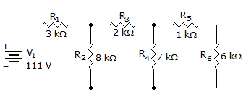
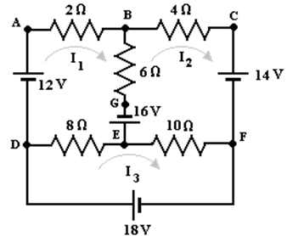
More Challenge Circuits Classwork
I₄

Slide 5
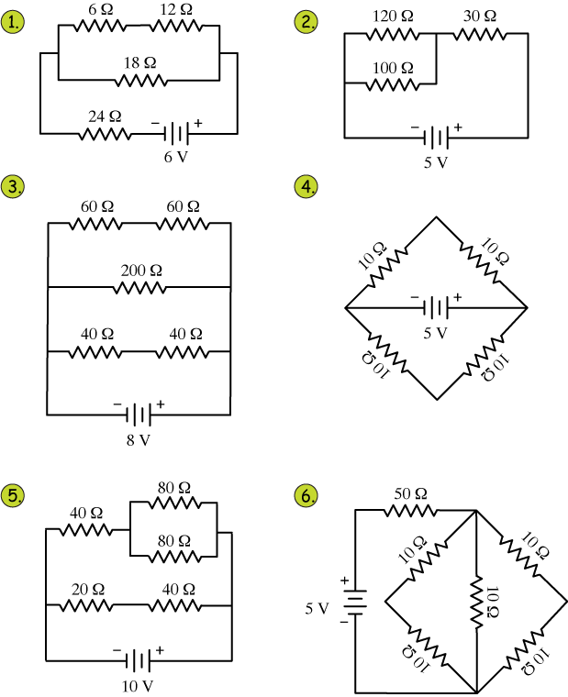
AND…More for an Assignment

Slide 6
Exit slip and homework
Exit Slip – Solve this circuit
Let R₁ = 120 , R₂ = 100 , and R₃ = 30 
What’s due? (homework for a homework check next class)
Extra practice within this ppt, p 226 #25-27
What’s next? (What to read to prepare for the next class)
Study for the Final

